Slide 1

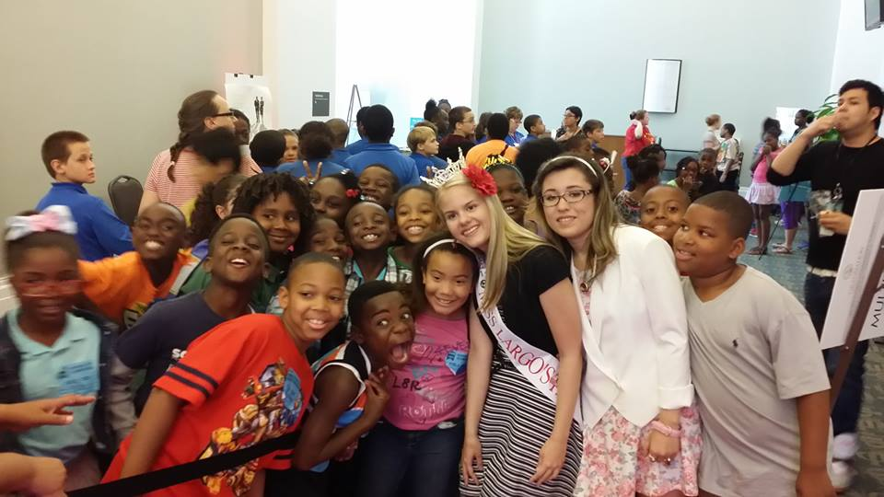
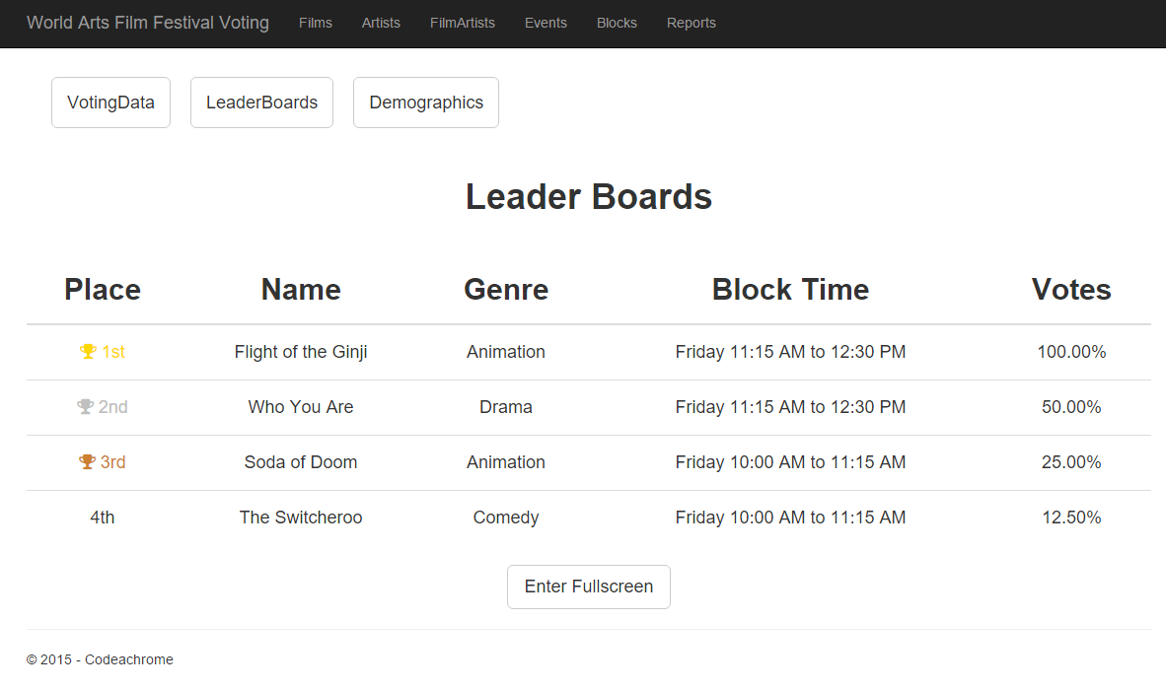
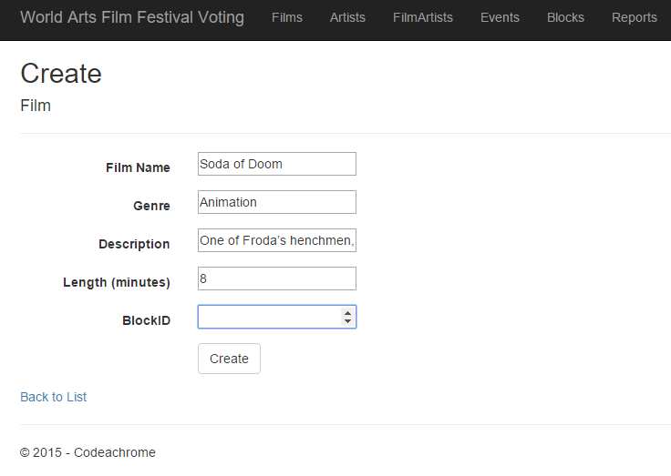
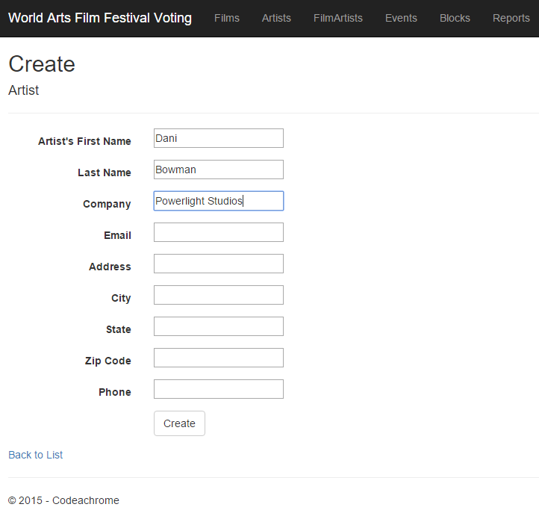
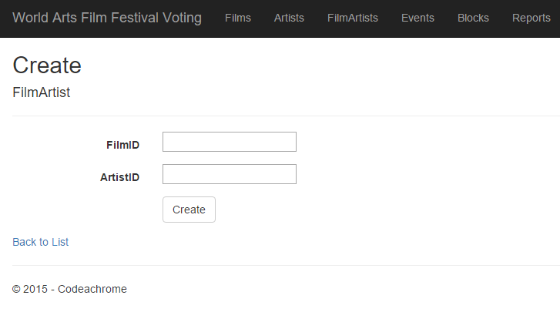
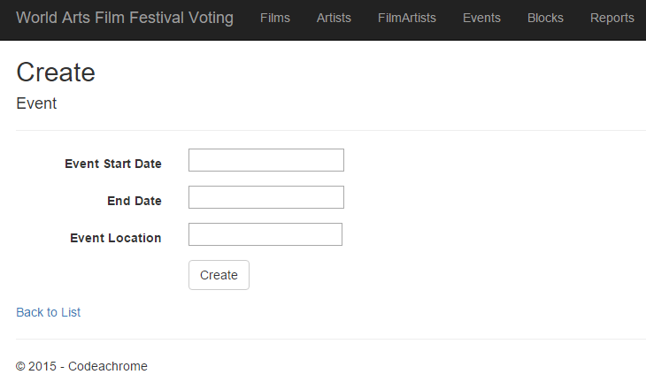
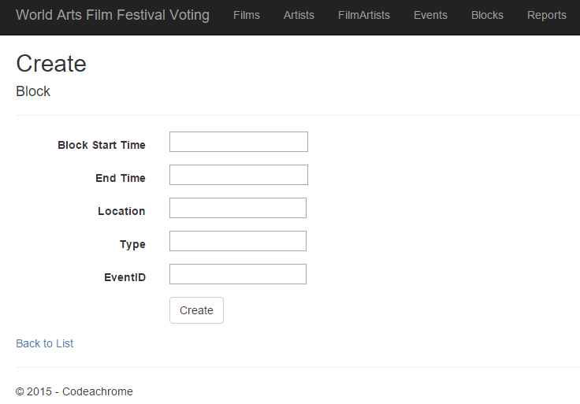
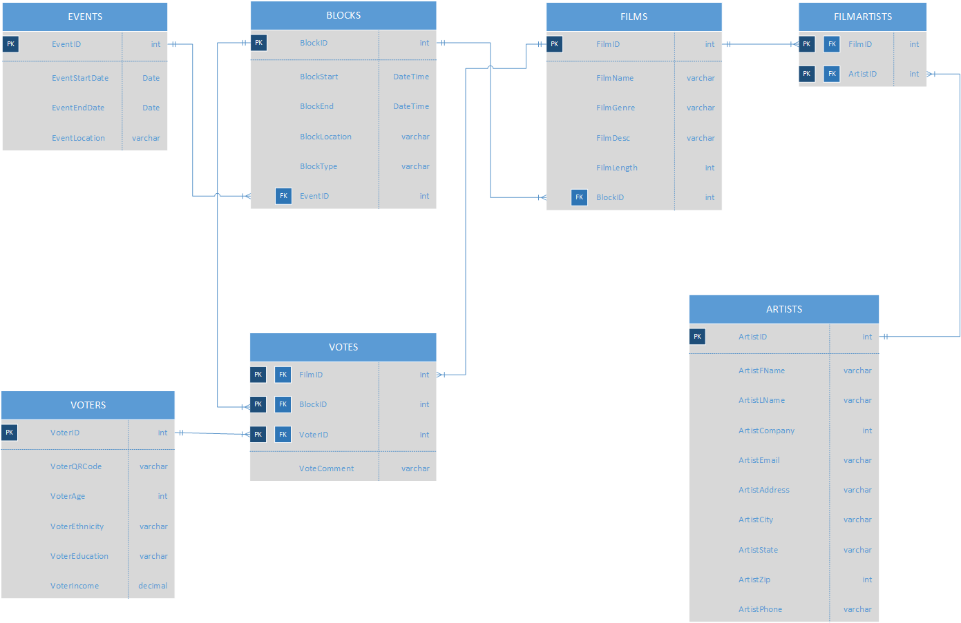
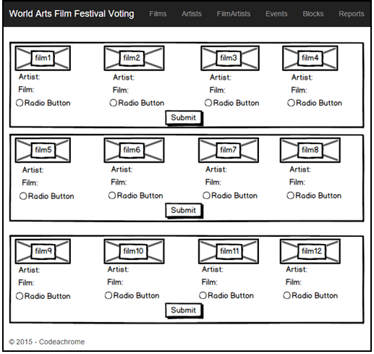
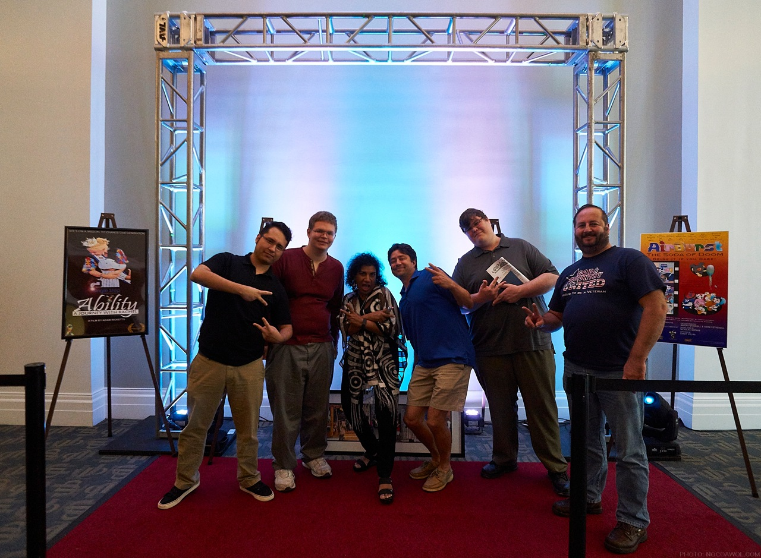
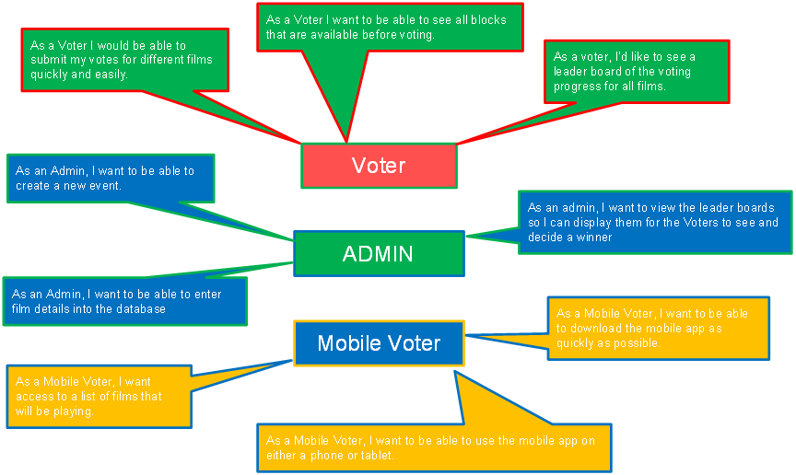
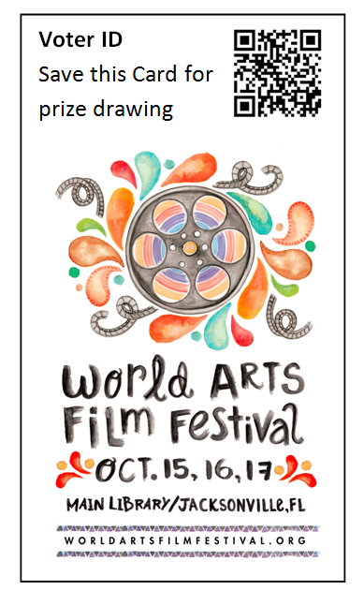
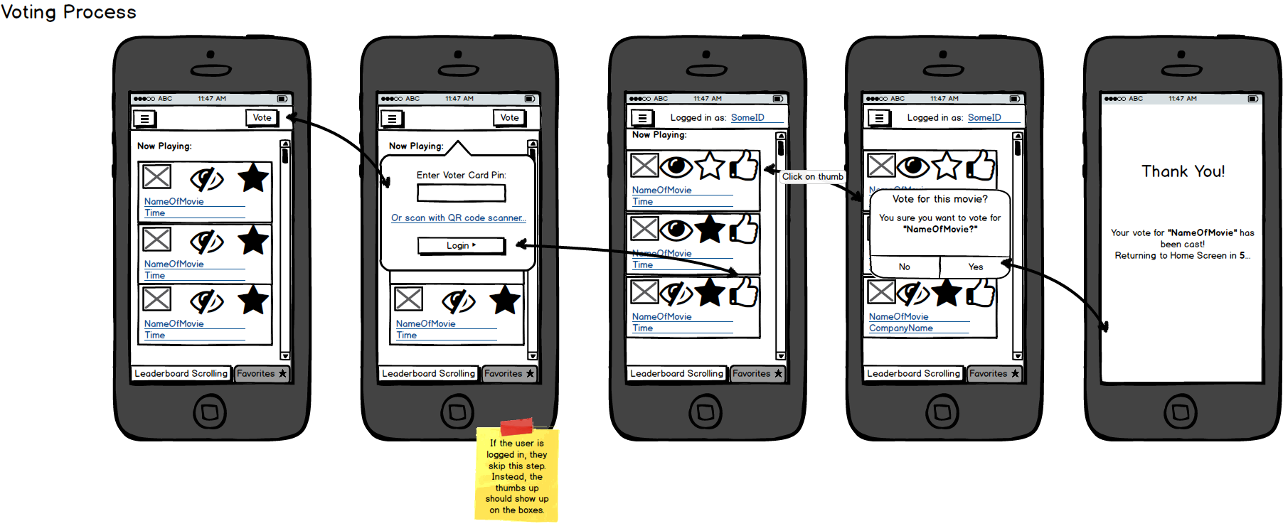









World Arts Film Festival e-Voting System
Team: Codeachrome, Feature [23]
Members: Donald Dedman, Jeremiah Doody,Timothy Folds, Julio Orozco and John Verdi
Mentors (Feature [23]): Nick Campanini, Mike Potts
Class: Senior Project I Professor: Karthikeyan Umapathy
University of North Florida, College, Jacksonville, FL USA 32224
WORLD ARTS FILM FESTIVAL
DEVELOPMENT STORY
SUMMARY
Problem: Our community partner is looking for a way to provide feedback to her contributing artist and engage the attendees of each event.
Administrator: Enters data on films and artists, creates associations and creates events and voting blocks with associated film. Implemented using Basic CRUD Functionality with the Entity Framework in ASP.NET MVC Application
Solution: After attending the event and gathering relevant materials regarding the event flow we have started development of a stand alone kiosk type voting platform as well as a mobile application.
Next year 5,000 attendees are expected to benefit from participating in the World Arts Film Festival including college-aged students, local and visiting filmmakers from over 30+ countries, men and women from Jacksonville area, New York and California, groups, families and individuals including those with special needs interested in the unique film festival experience.
Our e-Voting system will allow visitors to vote on films and give feedback from a kiosk or from their mobile phone. Our client hopes that this system will streamline the process of managing these events and increase the engagement of event participants and attendees.
Voters: Each attendee will be given a voter ID card containing a unique QR Code that when scanned by our mobile or kiosk platforms collects some optional demographic information and directs them to the voting page.
USER STORIES
FUTURE
Database: Our initial ERD defines all the entities and attributes that are relevant to the implementation of our e-Voting and Feedback system. Data collected from voters will be used to populate a leader board and provide attendees and participants feedback on the top films.
MOBILE DEVELOPMENT
We are confident that our conceptual design aligns well with our client’s needs and in the next semester we will focus on:
Finalizing database design
Ensuring voting methodology is sound
Enhancing reports
Theme design and appearance
Client review and testing
Client Implementation
In our e-Voting System we have accumulated roughly 40 different user stories so far. All of these user stories revolve around 3 actors; Voter, Admin, and Mobile Voter. Above is a snippet of just a couple of the user stories we came up with.

